Slide 1
UD5: INFERENCE
Part 1: Distributions in sampling
Part 2: Inference about one population
Comparison of 2 populations
Part 3: ANOVA (Analysis of Variance)
Design of Experiments
Part 4: Regression
1

Slide 2

UD 5 part 4
REGRESSION
Reference book – author: Rafael Romero
ETSINF library: 0-16 / 6, 37, 44, 45, 49-53, 61-66, 90, 95, 104-110, 120, 127-133, 140-153
2

Slide 3
TWO-DIMENSIONAL RANDOM VARIABLE
When two random numeric characteristics are observed from each individual.
Example: HEIGHT (cm) and WEIGHT (kg) of students.
95
85
WEIGHT
75
65
55
45
150
160
170
HEIGHT
180
190
200
Certain factory records every day the GAS CONSUMPTION for heating and the daily TEMPERATURE (ºC).
Weight of students from school A and school B
(it is nonsense to draw a scatterplot in this case)
3

Slide 4
Analysis of two-dimensional variables
Crosstabulation (contingency table): allows description of the relationship between the two qualitative components (if quantitative, data should be previously grouped into intervals).
Scatterplot: graphical representation of the relationship
95
85
75
65
55
45
150
160
170
180
190
200
Covariance and correlation coefficient: quantifies the intensity of the linear relationship.
Regression line: establishes a model of the relationship for predictive purposes.
4

Slide 5
QUALITATIVE VARIABLES:
  By means of a crosstabulation (contingency table)
REPEAT
Row
YES
NO
Total
SEX
5
41
  Relative frequency of “repeat” conditioned to sex
MEN
10.9
89.1
1
24
WOMEN
4.0
96.0
COLUMN
6
65
71
  Marginal frequency of “repeat”
TOTAL
8.5
91.5
Marginal frequencies: Frequency of each value of certain variable without taking into account the other.
Relative conditional frequencies: relative frequency of the value of certain variable in relation to each value of the other.
5

Slide 6
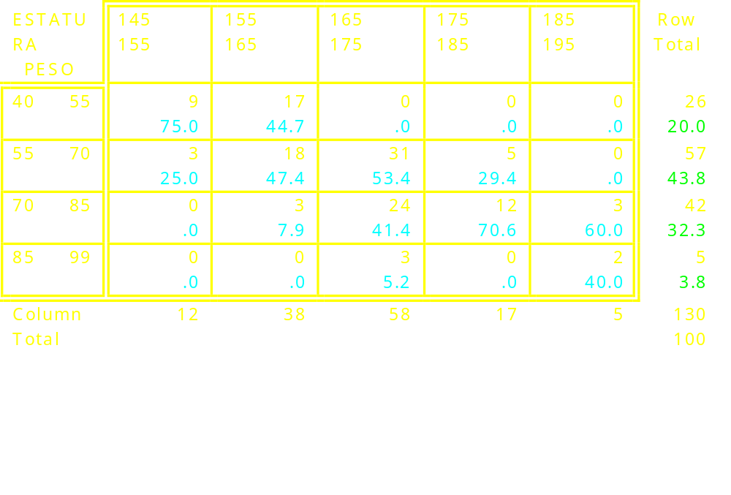
Quantitative continuous variables:
  By means of a contingency table after grouping the data into intervals.
HEIGHT
Marginal frequency of weight
Marginal frequency of “height”
Relative frecuency of weight conditioned to “height”
6
PROBLEM: certain information is lost in the tabulation

Slide 7
SCATTERPLOT
What color correspond to men and women?
95
85
75
WEIGHT
65
55
45
150
160
170
180
190
200
HEIGHT
How is the observed correlation: weak, moderate, strong?
7

Slide 8
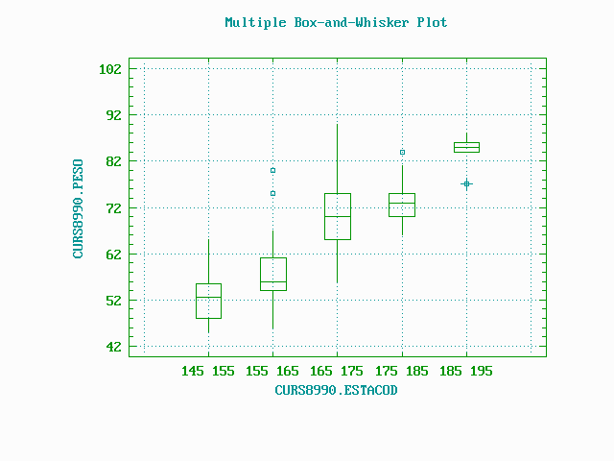
Multiple box-and-whisker plot
PROBLEM: some information is lot in the tabulation, but it is observed that conditional distributions are approximately normal: ¡this is one hypothesis of the regression model!
8

Slide 9
Weight (Kg)
90
Conditional distributions of weight with respect of height
Marginal distribution of Weight
80
70
60
50
Height (cm)
145-155
155-165
165-175
175-185
185-195
HEIGHT Nº of STANDARD
cases MEAN DEVIATION MIN. MAXIMUM
----------------------------------------------------------------------------------------------------
145-155 12 53.0000 6.39602 45 65
155-165 38 57.7895 7.45856 46 80
165-175 53 70.8793 7.61134 56 90
175-185 17 73.4118 4.71777 66 84
185-195 5 84.0000 4.18330 77 88
-----------------------------------------------------------------------------------------------------
Similar standard deviation: This is another hypothesis of the regression model (homoscedasticity)
9

Slide 10
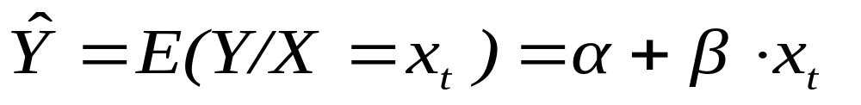
SIMPLE LINEAR REGRESSION: THEORETICAL MODEL
Y
Conditioanl distributions
E(Y/X₁)=m₁
E(Y/X₂)=m₂
m_{Y}
E(Y/X₃)=m₃
Marginal distribution of Y
Regression line
X₁
X₂
X₃
X
The conditional distribution Y / X=x_{t} is a random variable:
E(Y) = a + b ·X
Linear relationship at the population level between the two components of a bivariate random variable (X,Y)
Linear relationship estimated from the sample:
α = a
β = b
10

Slide 11
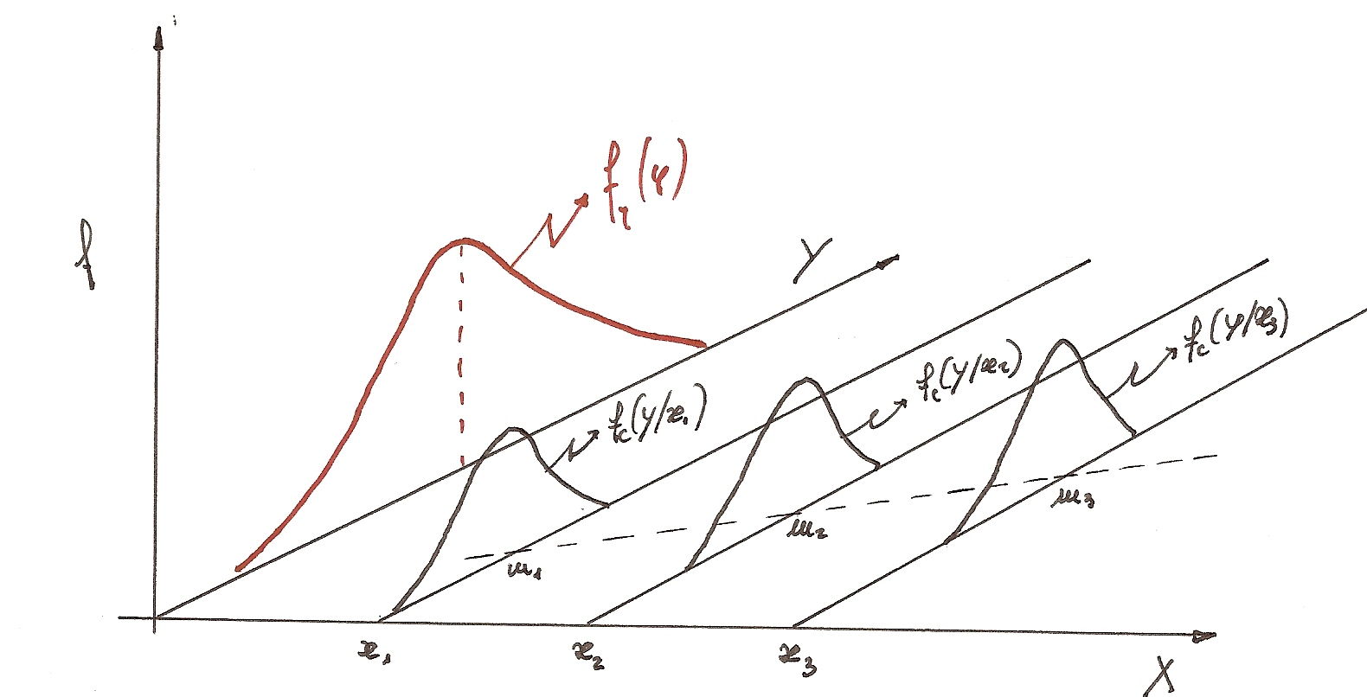
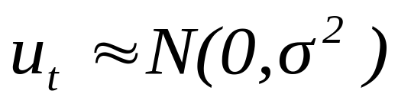
Conditional distribution Y/x : distribution of Y when x takes certain value
Marginal distribution of Y
Constant (hypothesis of homoscedasticity)
Variance of residuals (“residual variance”)
Residual = y_{observed} - y_{predicted}
e _{j} = y_{j} - (a + b·x _{j} )
Residuals:
11
( σ² of the conditional distrib. = σ² of residuals) ≤ σ² of Y

Slide 12
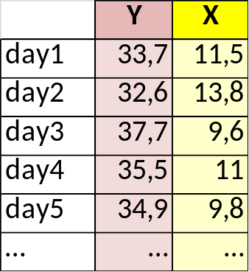
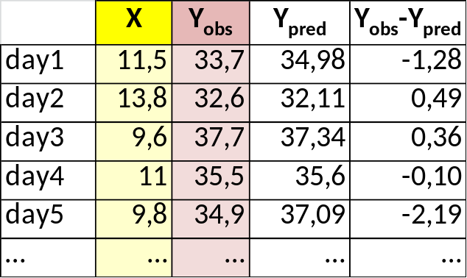
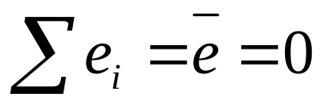
Y: gas consumption for heating in winter
Response variable
X: temperature of each day (ºC)
Predictive variable
42
Y
Y = a + b · X
38
b : slope
34
OBSERVATIONS
30
26
6
8
10
12
14
16
18
X
The fitted model predics the mean
Y = 49.3 – 1.24 · X
Residual = e = Y_{observed} – Y_{predicted}
RESIDUAL: is the error of the model (accounts for the effect of all the remaining factors not included in the model).
HYPOTHESIS: it is assumed that residuals are normally distributed and they are independent between them
12

Slide 13
REGRESSION: statistical tool used to establish a model (mathematical equation) able to predict values of a dependent variable Y as a function of one or more input variables (X₁,X₂, …,X_{j}).
Y = f(X) => simple regression
Y = f(X₁,X₂, …,X_{j}) => multiple regression (lineal or non-linear)
uncertainty
Empirical model:
Weight = 2.3 + 0.9 · height + error
error: random variable (other causes of variability)
partial
(based on observed data)
Empirical models do not always reflect cause-effect relationships
Deterministic model: F = m · a
nul
(physical laws)
Strength = mass · acceleration; E = m·c² ….
13
Causality: these models express cause-effect relationships

Slide 14
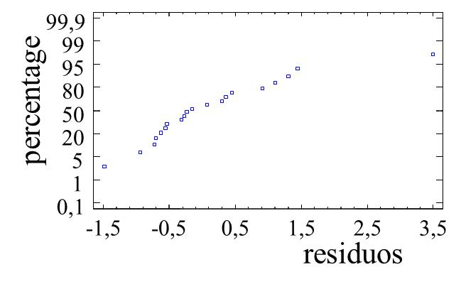
ANALYSIS OF RESIDUALS
We recommend to represent them o a normal probability plot for:
Detect outliers (abnormal values)
Outlier: the analysis should be repeated after discarding this value
Lack of normality in the data: in case of positive skew, data should be transformed (log, X^{0.5}, X^{0.25})
Lack of linearity in the relationship Y = f(X): it can be studied by representing residuals e_{i} as a function of X_{i}
3,2
3,2
2,2
2,2
residual
1,2
1,2
0,2
residual
0,2
-0,8
-0,8
-1,8
-1,8
-2,8
X
-2,8
8
10
12
14
16
8
10
12
14
16
X
14
Linear relationship, constant s²
Quadratic relationship

Slide 15
How to quantify the degree of correlation between 2 variables:
∑
−
−
Covariance
(X
X
)(Y
Y
)
Cov
=
i
i
(X,
Y)
N
−
1
N = nº of individuals (pairs of values)
Plot of Consumption vs Temperat
Cov < 0
X=Xmean
Cov >0
Y = a + b·X
500
b<0 → cov<0
b>0 → cov>0
400
300
Y= Ymean
Consumption
200
Cov >0
Cov <0
Y_{i} -Ymean < 0
100
X_{i} -Xmean > 0
0
-3
1
5
9
13
17
21
Temperature
15

Slide 16
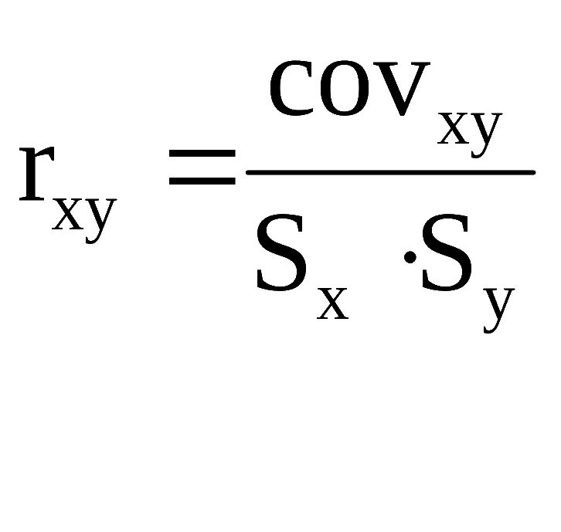
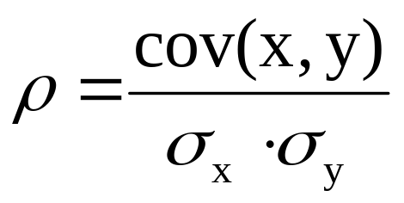
If covariance = -50, is the correlation between two variables weak or strong?
Drawback: it depends on the units (scale) in which variables are measured.
Pearson’s CORRELATION COEFFICIENT
At sample level:
At the population level:
If ρ = 0 → no linear relationship exists between X and Y
If ρ = +1 → exact linear relationship between X and Y
Advantage: is non-dimensional
-1 < r_{xy} < 1
16

Slide 17
Matrix of variances - covariances
Matrix of covariances
cov (x₁, x₁) cov (x₁, x₂)
var (x₁) cov (x₁, x₂)
cov (x₂, x₁) cov (x₂, x₂)
cov (x₁, x₂) var (x₂)
σ²_{x}
cov (x₁, x₁) cov (x₁, x₂) cov (x₁, x₃)
The matrix is symmetric
cov (x₂, x₁) cov (x₂, x₂) cov (x₂, x₃)
cov (x₃, x₁) cov (x₃, x₂) cov (x₃, x₃)
r_{xx} r_{xy}
1 0.7404
Matrix of correlation
r_{yx} r_{yy}
0.7404 1
17

Slide 18
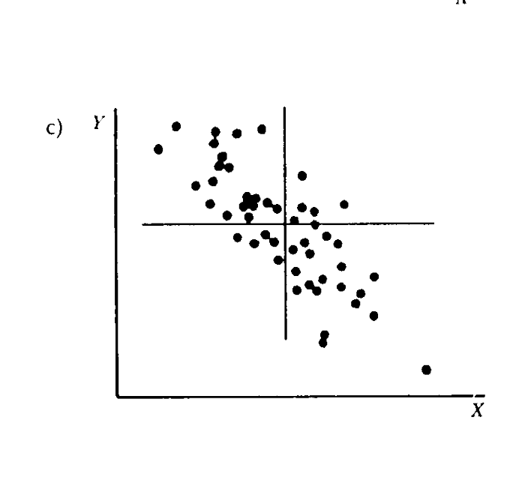
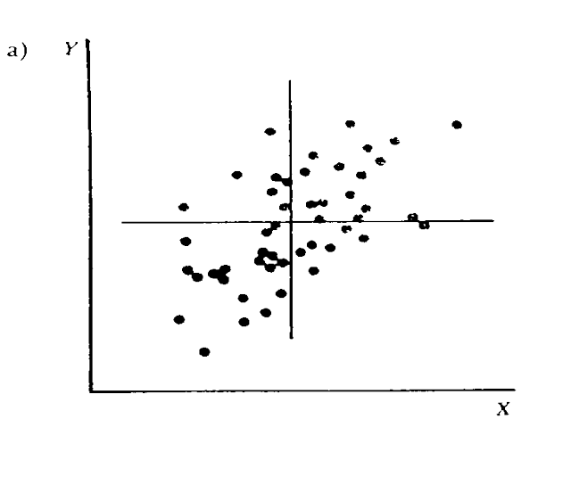
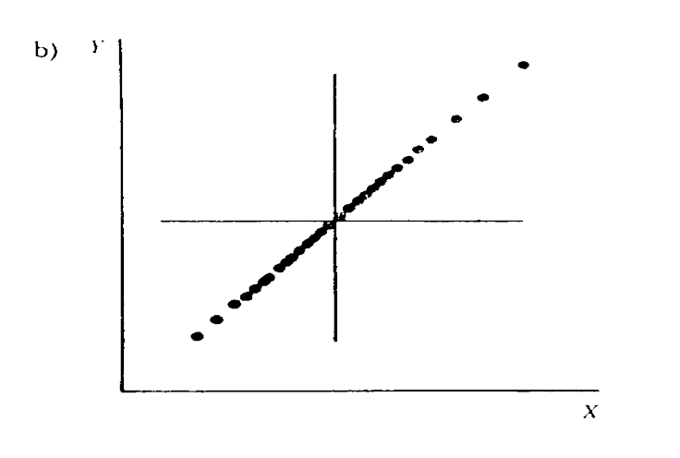
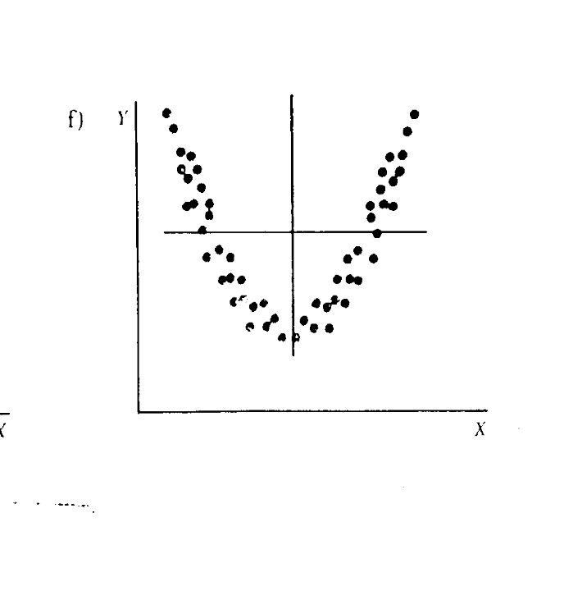
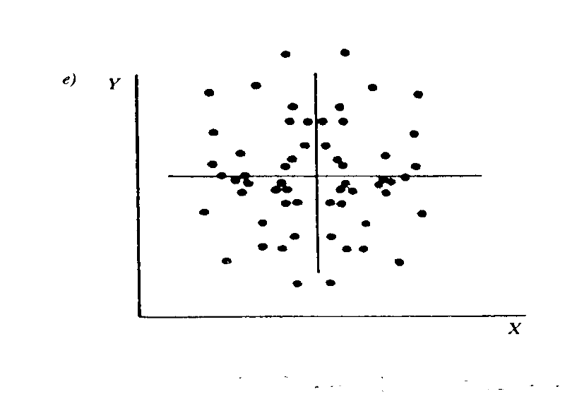
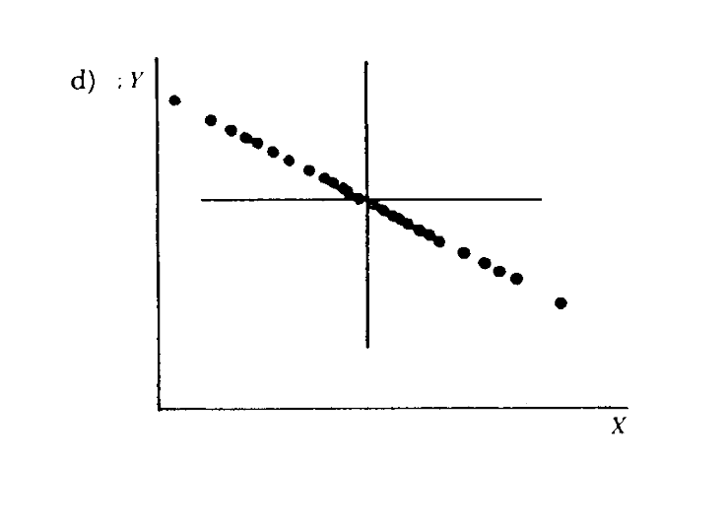
INTERPRETATION OF REGRESSION MODELS
r>0
moderate correlation
r=1
weak correlation
r<0
R² > 0
r=-1
r=0
r=0
18
R²: coefficient of determination

Slide 19
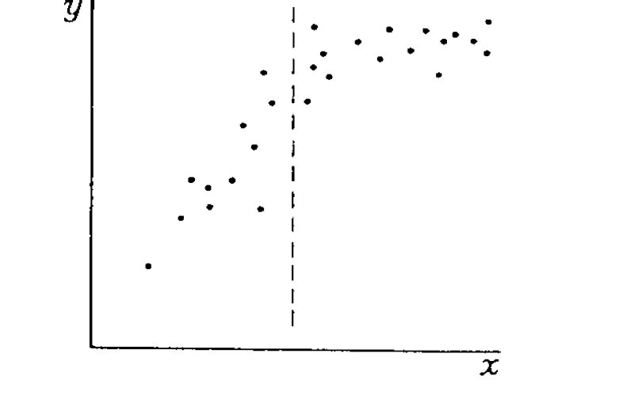
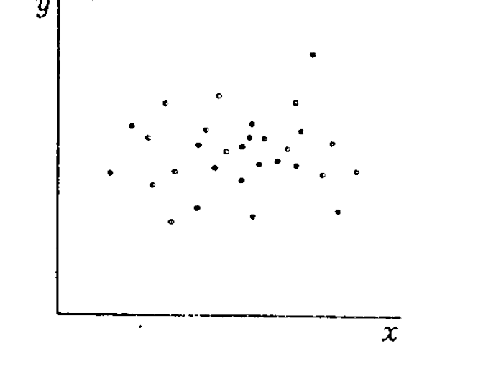
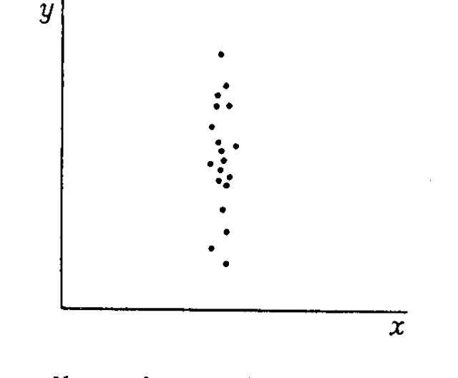
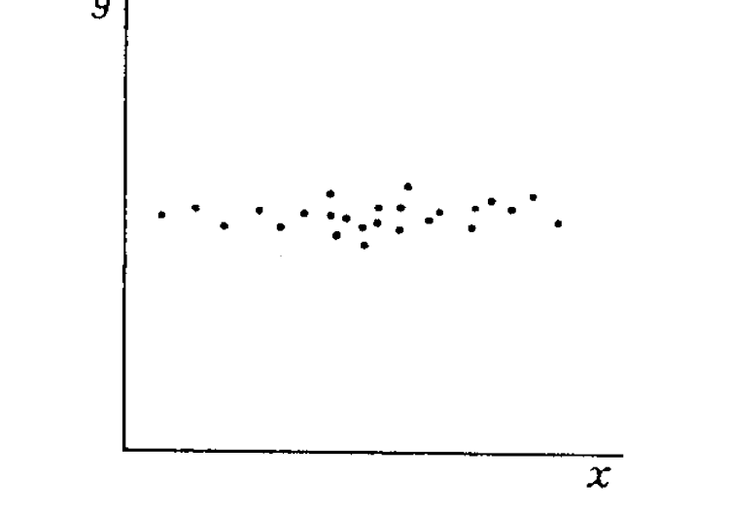
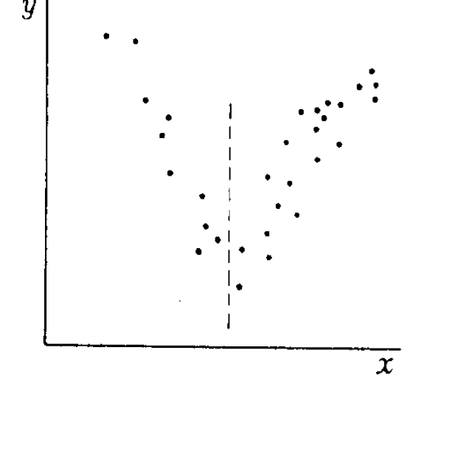
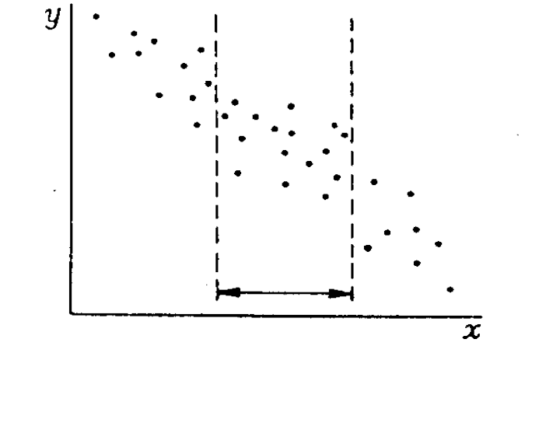
INTERPRETATION OF REGRESSION MODELS
The line is not vertical
r=0
r=0
r>0
quadratic effect
not correlated
r=0
r<0
not correlated
cubic effect?
quadratic effect
19

Slide 20
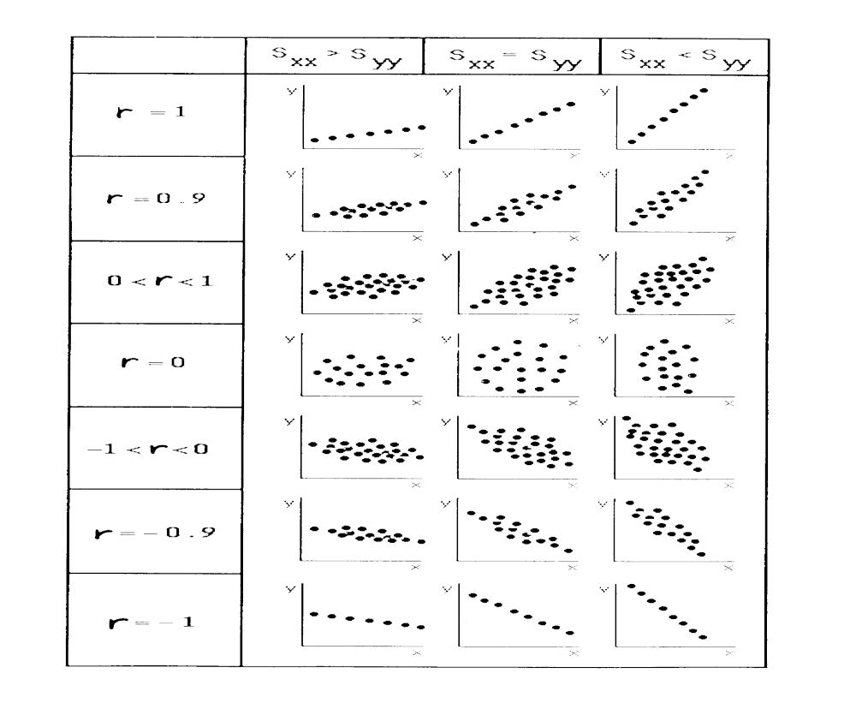
EXAMPLES OF CORRELATION COEFFICIENTS
Correlation:
maximum
strong
moderate-weak
nul
moderate-weak
strong
maximum
20

Slide 21
EXAMPLE: The government wants to promote the use of computers among citizens.
INTERPRETATION OF RELATIONSHIPS BETWEEN 2 VARIABLES
- Certain study reveals that, in Spanish homes, the annual spending on computers is positively correlated with the spending on shoes.
- CONCLUSION: the government decides to promote the spending on shoes (by lowering the prices) in order to incentivate the use of computers.
Spending on shoes
Not cause-effect relationship
Nº children per family, age, level of studies, family income...
Spending on computers
partial dependence
21

Slide 22
IMPORTANT RULE: THE OBSERVED CORRELATION BETWEEN 2 VARIABLES DOES NOT IMPLY NECESSARILY A CAUSE – EFFECT RELATIONSHIP
EXAMPLE: in a chemical process it is observed that certain quality parameter Y is positively correlated with temperature (T) at certain point.
CONCLUSION: it is recommended to increase T for increasing Y.
INTERPRETATION OF RELATIONSHIPS:
One-way cause-effect dependence
CAUSE EFFECT
Room temperature
Power consumption for heating
Amount of rain
Amount of water in reservoirs
Speed of computer processor
Time required to carry out a computational operation
22

Slide 23
INTERPRETATION OF RELATIONSHIPS
Partial dependence of one or more variables:
CAUSE (X) EFFECT (Y)
Genetic characteristics
Height and weight
Family income
Expenses in shoes of families
Final score in the exam
Attendance to theory and practical classes
Final score in the exam
Nº hours of study of Statistics
X₁ = f(X₂)?
Interdependence between X₁, X₂:
X₂ = f(X₁)?
Score in Mathematics vs. score in Statistics
Weight of a person vs. height
In a married couple, age of husband vs. wife
23

Slide 24
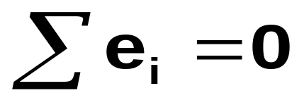
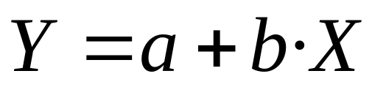
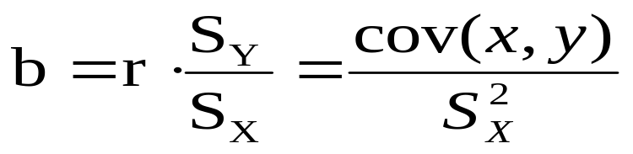
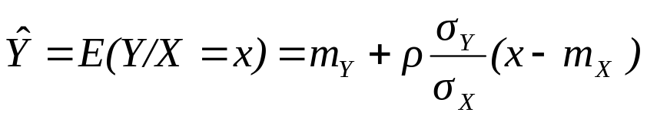
CALCULATION OF THE REGRESSION LINE
Y
e_{i} > 0
minimize Σ e_{i}²
e_{i} <0
Ordinary least squares regression (OLS)
X
Y
e_{i}
a = Y – b · X
X
Regression line (alternative equation):
24

Slide 25
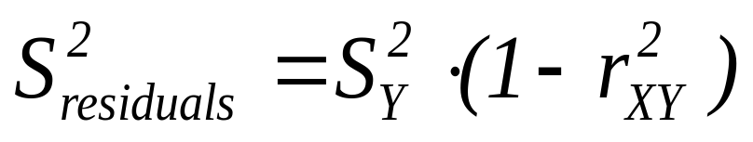
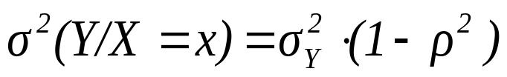
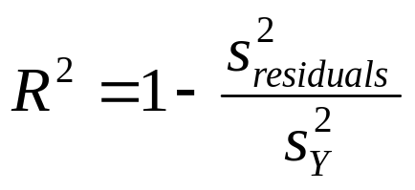
INTERPRETATION of r²
Y/X=x_{o}
Y
Y
Y/X=x_{o}
x_{o}
X
x_{o}
X
r²=0 ; b=0 ; S²_{res} = S²_{y}
0 < r² < 1 ; S²_{res} < S²_{y}
X, Y are independent
Not depends on X
(homoscedasticity)
r² : proportion of the variability of Y explained by the model
In simple regression:
Coefficient of determination (R²) = (correlation coefficnet)² = r²
25
Indicates the “goodness-of-fit” of the model

Slide 26
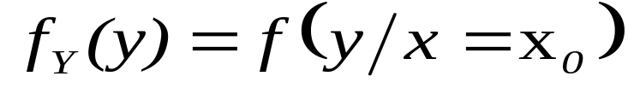
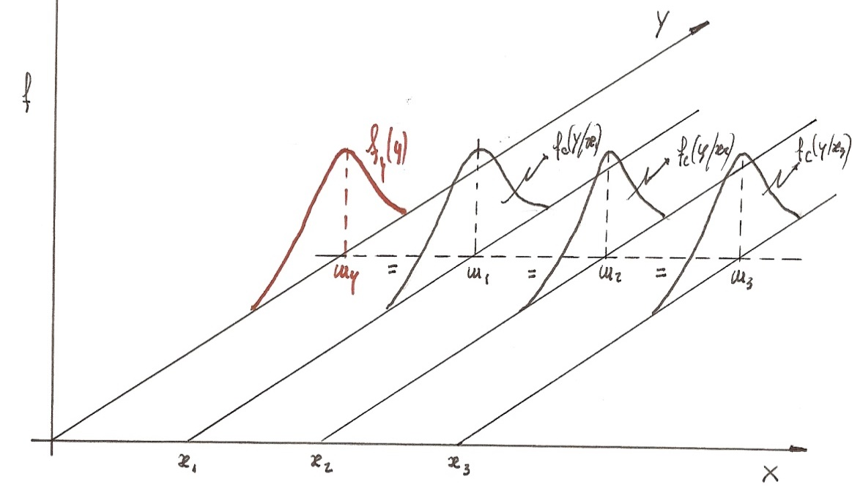
INDEPENDENCE OF 2 CONTINUOUS VARIABLES
Two components X, Y of a bivariate random variable are independent if the events (X≤x) and (Y≤y) are independent
EXAMPLE: height vs. time required to arrive at university.
80
TIME
60
40
If X, Y are INDEPENDENT:
20
0
150
160
170
180
190
200
HEIGHT
If are independent (not correlated), the regression line is horizontal : the best prediction is the mean of Y
The distribution of “time” will be the same for any height and the same for the marginal distribution
26
height

Slide 27
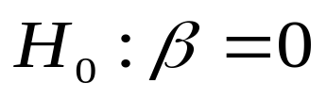
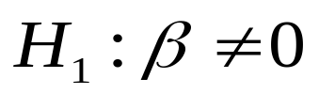
Is the correlation of X vs. Y statistically significant?
At sample level: Y = 20 + 0.2 X
At the population level: Y = α + β X
p < α
Reject H₀: correlation “statistically significant”
(r ≠ 0 at the population)
p > α
Accept H₀: X, Y are independent
Regression Analysis - Linear model: Y = a + b*X
----------------------------------------------------------------------
Parameter Estimate Standard Error T statistic P-Value
----------------------------------------------------------------------
Intercept -84,0714 12,0274 -6,99002 0,0000
Slope 0,869429 0,0694856 12,5124 0,0000
----------------------------------------------------------------------
27
12.512 = 0.869 / 0.0694
The same for “a”

Slide 28
  ANALYSIS WITH STATGRAPHICS
  Data of weight (kg) and height (cm) of 131 students at UPV
Regression Analysis - Linear model: Y = a + b*X
------------------------------------------------------------------------
Dependent variable: WEIGHT
Independent variable: HEIGHT
------------------------------------------------------------------------
Standard T
Parameter Estimate Error Statistic P-Value
------------------------------------------------------------------------
Intercept -84,0714 12,0274 -6,99002 0,0000
Slope 0,869429 0,0694856 12,5124 0,0000
------------------------------------------------------------------------
Weight = -84.07 + 0.869 · height
Interpretation of b: when height increases 1 cm, the weight increases 0.869 kg on average
b: average increase of Y expected if X increases 1 unit
Interpretation of a: when height = 0, the expected weight (on average) will be ─84.07 kg
Nonsense?
RULE: Any regression model is only valid within the range of X values for which is has been fitted.
28

Slide 29
b) Weight = a + b · (height - 150)
  Dependent Var.: WEIGHT
  Independent Var.: HEIHT ─ 150
  Parameter Estimate Standard error T statistic P-value
  Intercept 46,343 1,7078 27,1355 0,0000
  Slope 0,869 0,0695 12,5124 0,0000
  Analysis of Variance
  Source Sum of Squares Df Mean Square F-Ratio P-Value
  Model 8094,44 1 8094,44 156,56 0,0000
  Residual 6669,58 129 51,70
  Total 14764,00 130
Weight = 46.34 + 0.869 · (height-150)
Interpretation of a: if height=150 cm, the expected weight = 46.34 kg
Weight = ─84.07 + 0.869 · height
Which model is better?
Both are identical !
Which model has a simpler interpretation?
Nº observations = 1 + Df total
In simple regression, p-value of “ANOVA” = p-value of the slope
29

Slide 30
  Parameter Estimate Standard error T statistic P-value
  Intercept 46,343 1,7078 27,1355 0,0000
  Slope 0,869 0,0695 12,5124 0,0000
  Analysis of Variance
  Source Sum of Squares Df Mean Square F-Ratio P-Value
  Model 8094,44 1 8094,44 156,56 0,0000
  Residual 6669,58 129 51,70
  Total 14764,00 130
Correlation Coeficient 0,7404
R-squared: 54,83 %
Standard Error of Est. = 7,1904
R² = 0.7404² = 0.5483
Residuals → standard deviation = 7.1627
a) What is the standard deviation of weight if height = 175?
7.19
b) Obtain a confidence interval at 95% for the weight of those students with height = 175 cm.
(-84,07+0.869·175) + 2 · 7.19
30

Slide 31
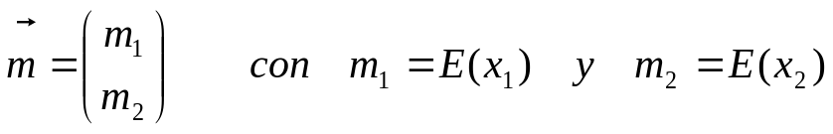
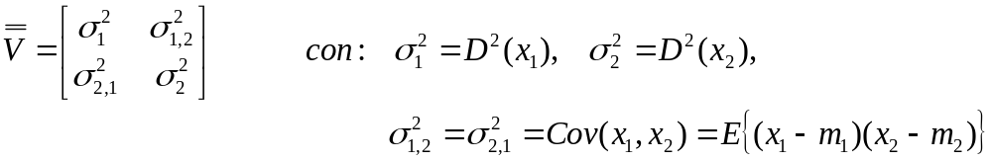
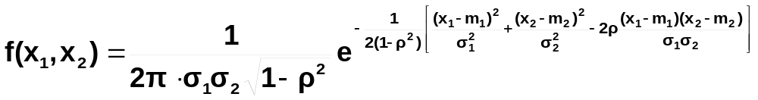
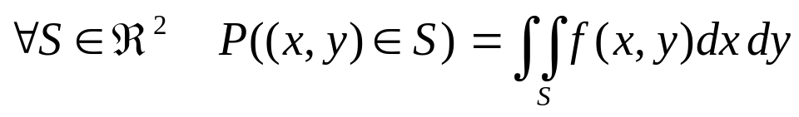
BIVARIATE NORMAL DISTRIBUTION
Vector of means
Matrix of variances covariances
The 2 components X₁, X₂ of a bivariate random variable follow a normal bivariate normal distribution if the joint density function is:
m₁ (mean of X₁), m₂ (mean of X₂), σ₁² (variance X₁), σ₂² (variance X₂)
ρ is the correlation coefficient between X₁ and X₂
31

Slide 32
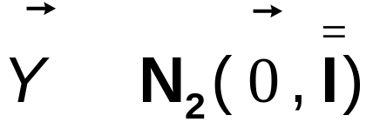
m₁ = 0, m₂ = 0, σ₁² = 1, σ₂² = 1, r = 0
∼
BIVARIATE NORMAL DISTRIBUTION
ISODENSITY CURVES
Bivariate Density Function
3
2
1
0.16
Z
Y
0
0.12
-1
0.08
-2
0.04
3
2
-3
1
0
0
-3
-2
-1
0
1
2
3
-1
X
-3
-2
Y
-2
-1
0
-3
1
2
3
X
Volume below the surface = 1,
probabilities are obtained by integration
32

Slide 33
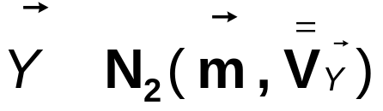
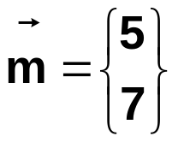
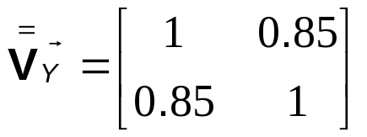
∼
m_{x} = 5, m_{y} = 7, σ_{x}² = 1, σ_{y}² = 1, r = 0.85
NORMAL BIVARIATE DISTRIBUTION
ISODENSITY CURVES
Bivariate Density Function
Bivariate Normal Surface
10
9
0.4
8
0.3
Y
7
Z
0.2
6
0.1
10
9
8
5
0
7
6
2
5
Y
4
3
4
5
4
6
7
8
2
3
4
5
6
7
8
X
X
33

Slide 34
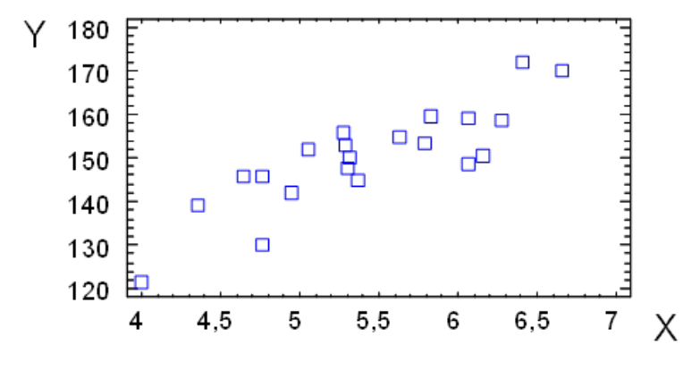
EXERCISE OF EXAM – MAY 2019
Certain company that produces breakfast cereals wants to study the relationship between the sales as a function of expenses on children’s television advertising (both variables, measured in thousand euros). A study is carried out by collecting the monthly values corresponding to the last 21 months. The following plot was obtained from these data:
a) What would be the independent variable X and the dependent variable Y in this context? What can be deduced at the sample level?
b) The following table of a linear regression model, fitted with the data, was obtained with the software Statgraphics:
(see next slide)
What % of the variability of monthly sales is explained by other variables which are not the monthly expenses in advertising (for example: price, amount of sales and price of competitive products, etc.)?
34

Slide 35
Regression Analysis - Linear model: Y = a + b*X
-----------------------------------------------------------------------------
Standard T
Parameter Estimate Error Statistic P-Value
-----------------------------------------------------------------------------
Intercept 75,0224 10,7008 7,01093 0,0000
Slope 13,8411 1,9562 7,0755 0,0000
-----------------------------------------------------------------------------
Analysis of Variance
-----------------------------------------------------------------------------
Source Sum of Squares Df Mean Square F-Ratio P-Value
-----------------------------------------------------------------------------
Model 1919,29 1 1919,29 50,06 0,0000
Residual 728,415 19 38,3376
-----------------------------------------------------------------------------
Total (Corr.) 2647,7 20
c) Write the mathematical equation of the regression model after estimating the value of the parameters and their statistical significance (α = 5%). What is the practical interpretation of the values obtained for the estimated parameters in the context of the problem?
d) Assuming that all hypotheses of the regression model are satisfied, what is the probability of obtaining monthly sales > 140,000 € if the expenses on children’s advertising are 4,000 €? What is the statistical model of conditional distribution that should be considered to calculate this probability?
35
See solution in PoliformaT (collection of solved exams)

Slide 36
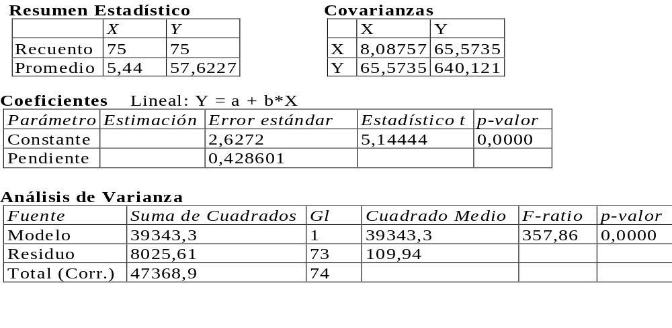
EXERCISE OF EXAM – MAY 2017
A small business with a printer wants to study the relationship between the time required for printing a document (Y) and the number of pages of the document (X). For this purpose, a sample of documents has been collected and for each of them, the number of pages and the printing time have been registered. The following results were obtained:
a) Calculate the Correlation Coefficient between the variables under study and describe the relationship between them.
b) What would be the aspect of the scatterplot depicting X vs. Y? Draw an approximate representation.
36

Slide 37
c) Estimate the parameters of the regression model that predicts the printing time of a document as a function of the number of pages.
d) Study the statistical significance of each parameter in the model (α=0.05). What is the estimated equation of the regression model?
e) According to the proposed model, what printing time is expected on average for a document containing 6 pages?
f) For the resulting model, what parameter quantifies the quality of the fitting to the data? Calculate the value of such parameter and provide an interpretation in this context.
g) Calculate the residual variance and indicate the interpretation of such value in the context of this study.
See solution in PoliformaT (collection of solved exams)
37

Slide 38
EXERCISE OF EXAM – JUNE 2017 - A
In order to study the performance of certain database, the mean load of the system has been recorded during 3 months by measuring the number of queries per minute (X) and the mean response time in seconds (Y).
The following parameters were computed from the collected data: X̅= 3.5 S_{x}= 0,65 Y̅=1.3 S_{Y}=0.6 r_{XY} = 0.9
a) Write the regression line able to estimate the mean response time according to the number of queries. What is the interpretation of the value estimated for the slope of this line?
b) Calculate value of the coefficient of determination. What is the practical interpretation of this value?
c) If certain day the load was 7 queries / min, what is the probability of obtaining a mean response time > 5 seconds?
See solution in PoliformaT (collection of solved exams)
38

Slide 39
EXERCISE OF EXAM – JUNE 2017 - B
During a period of 5 years, it was found that the correlation coefficient between the number of sick people with a cold (recorded weekly in a city) and the amount of beer sold is -0.82.
a) This study seems to suggest that beer consumption helps to prevent colds. What do you think about this statement?
b) The study has also calculated the correlation between the amount of beer consumed during the 1st week of August by 25 families in this city and 25 families from a neighboring city. In that case, the correlation coefficient was positive. What would you comment about the calculation of this correlation coefficient?
See solution in PoliformaT (collection of solved exams)
39

Slide 40

MULTIPLE LINEAR REGRESSION
Basic reference: book of Rafael Romero
ETSINF library: 0-16 / 6, 37, 44, 45, 49-53, 61-66, 90, 95, 104-110, 120, 127-133, 140-153
40

Slide 41
MULTIPLE LINEAR REGRESSION MODEL
· J observations of one random variable Y_{J.}
· The values corresponding to I variables (random or no) X_{1j} , ... , X_{ij} , which may explain (or not) the variability of Y.
VARIABLE TO EXPLAIN (RANDOM)
EXPLICATIVE VARIABLES OR FACTORS
(RANDOM OR NOT)
Y₁
X₁₁ , ... , X_{i1} , ... , X_{I1}
.....
....................
Y_{j}
X_{1j} , ... , X_{ij} , ... , X_{Ij}
.....
....................
Y_{J}
X_{1J} , ... , X_{iJ} , ... , X_{IJ}
THE TARGET IS TO STUDY possible relationships between the distribution of Y_{j} and the values of X_{ij .}
Y : DEPENDENT VARIABLE
X_{i} : INDEPENDENT, EXOGENOUS OR EXPLICATIVE VARIABLES OF THE MODEL
41

Slide 42
CLASSICAL REGRESSION MODELS ASSUME THAT:
Each observation y_{j} is the observed value of a random variable Y_{j} normal:
- variance σ² (Y_{j}) unknown but constant:
hypothesis of HOMOSCEDASTICITY
- The average of Y is a function of the observed values of X_{ij} : E(Y_{j}) = f(X_{1j} , ... , X_{ij})
Y_{j} ≈ N [ E(Y_{j} ) = f (X_{1j} ,…, X_{ij} ) ; σ² (Y_{j} ) = constant ]
E(Y / X₁ = x_{1t} , …, X_{I} = X _{It} ) = β₀ + β₁ x_{1t} + … + β_{I} x_{It}
EQUATION OF THE MODEL :
β₀ : average value of Y when X₁ = … = X_{I} = 0
β_{i} increase in the average value of Y when X_{I} increases one unit and the rest of explicative variables remain constant.
42

Slide 43

STAGES IN A REGRESSION STUDY:
1º) FORMULATION OF THE MODEL
- Precise definition of the dependent variable Y
- Selection of explicative variables X₁, X₂ ...
- Selection of the analytic equation for the model.
- Transformation (if necessary) of the variables.
2º) TO COLLECT THE DATA
3º) CALIBRATION OF THE MODEL
Estimated coefficients (software)
4º) MODEL VALIDATION:
Analysis of residuals
e_{t} = y_{t} – (b₀ + b₁ x_{1t} + … + b_{I} x_{It} )
Distribution N(0; σ²); are independent among them
· Are normally distributed? Any outlier is detected?
· Can we admit the hypothesis of homoscedasticity?
· Is actually linear the relationship between Y and every X _{i} ?
43
5º) EXPLOITATION OF THE MODEL

Slide 44
STUDY OF QUADRATIC EFFECTS
Non-linear relationships can often be approximated by means of 2nd-order curves:
y = a + b·X + c·X²
Y
X₁
Simple regression: Weight = -84.07 + 0.869 · Height
R² = 0.548
Multiple regr.: Weight = –438 + 4.96 · H –0.0118 · H²
R² = 0.563
Which model is better?
Dependent variable: WEIGHT
-----------------------------------------------------------------------------
Standard T
Parameter Estimate Error Statistic P-Value
-----------------------------------------------------------------------------
CONSTANT -438,06 168,896 -2,59367 0,0106
HEIGHT 4,95573 1,94605 2,54655 0,0121
HEIGHT^2 -0,0117604 0,00559728 -2,10109 0,0376
-----------------------------------------------------------------------------
R-squared = 56,3315 percent
Standard Error of Est. = 7,0971
Y= β₀ + β₁·x + β₂·x²
H₀: β₂ = 0
The quadratic model is better for α=5%, the linear is better for α=1%
44

Slide 45
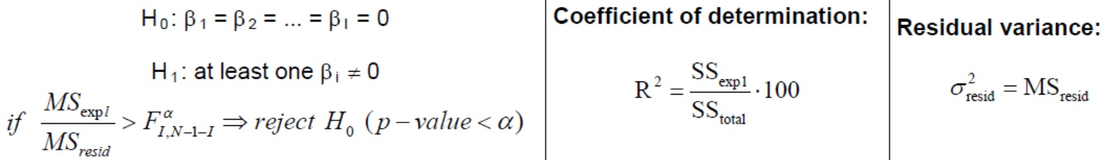
Analysis of Variance
-----------------------------------------------------------------------------
Source Sum of Squares Df Mean Square F-Ratio P-Value
-----------------------------------------------------------------------------
Model 8316,8 2 4158,4 82,56 0,0000
Residual 6447,22 128 50,3689
-----------------------------------------------------------------------------
Total (Corr.) 14764,0 130
Global significance test of the model (ANOVA)
At least one of the coefficients multiplying the variables is ≠ 0 at the population level (i.e., the model is able to make predictions).
EXERCISE: write the model equation:
Dependent variable: WEIGHT
---------------------------------------------------------------------
Parameter Estimate St. Error T statistic P-Value
---------------------------------------------------------------------
CONSTANT -373,043 171,193 -2,17908 0,0012
X1 -0,0694785 0,0382825 -2,81489 0,0019
X2 4,24816 1,96785 3,15878 0,0027
X3 -0,00978766 0,00565328 -3,73133 0,0058
---------------------------------------------------------------------
All variables included in the model should have coefficients ≠ 0 at the population level (p < α)
45

Slide 46
QUALITATIVE VARIABLES IN REGRESSION MODELS
Example: the yield of a chemical process (Y) depends on the type of raw material (A or B) and on the temperature.
Create one indicator variable (dummy) Z by coding: Z
Raw material A → 0
Fitted model:
Raw material B → 1
Y = 50 + 0.5 · Tª + 20 · Z + 0.1 · Z · Tª
Fitted line for raw material A → Z=0 → Y = 50 + 0.5 · Tª
Fitted line for raw material B → Z=1 → Y = (50 + 20) + (0.5+0.1) · Tª
If all coefficients of this model are statistically significant, it corresponds to 2 lines with ≠ slope and ≠ ordinate
Z_{A} Z_{B}
In case of 3 raw materials we should create 2 indicator variables:
Raw material A → 1 0
Raw material B → 0 1
Raw material C → 0 0
46

Slide 47
Main problem of MLR: presence of high collinearity
1) If X₁, X₂ are identical
Y = 13 – 8 X₁
if X₂ is added, is irrelevant
Y = 13 – 8 X₁ + 0 X₂
Y = 13 – 8 X₂
if X₁ is added, is irrelevant
Y = 13 – 8 X₂ + 0 X₁
Y = 13 – 8 (X₁+X₂)/2
impossible to estimate regression coefficients
2) If X₁, X₂ are strongly correlated
Y = 13 – 7.5 X₂ + 0.5 X₁
Coefficient of X₁ small (perhaps not significant): why does X₁ not enter in the model if it is correlated with Y?
Because this effect of X₁ is already explained by other variables (correlated with it) that are present in the model.
Model “unstable”: small changes make that p-values of correlated variables undergo big differences → difficult interpretation and variable selection.
3) Solutions
- Careful selection of variables (decide to use X₁ or X₂)
- Use of means (X₁+X₂)/2 for reducing the measurement error:
Methods based on latent structures are based on this idea (PCR, PLS…)
47

Slide 48
HISTORIC EVOLUTION: “THE NEW ERA OF BIG DATA”
Background of Multiple Linear Regression (MLR):
Legendre (1805), Gauss (1809), Galton (1889), Pearson (1925)
MLR: 1805-1925
1930: first calculators
years 1960 - 70
Sophistication of computers
Development of spectroscopy, chromatography...
Statistical software available
High collinearity
PROBLEM: Nº variables >>> Nº observations
High Nº variables → presence of collinearity (correlated variables)
SOLUTION: - stepwise regression [forward / backward]
(automatic method of variable selection)
- Methods based on “latent structures”:
Origin: Principal Component Analysis (PCA): Pearson (1901), Hotelling (1933), Wold (1964)
Principal Component Regression (PCR)
1977: PLS regresion (Partial Least Squares regression)
Success in the area of instrumental analysis (chemometrics)
Copes with high collinearity, missing data, several Y
48
Software: SIMCA-P, Aspen ProMV, Unscrambler, PLS_toolbox…

Slide 49
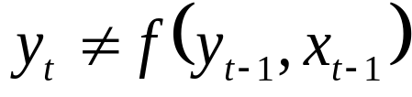
DIFFERENCES: MLR vs. methods based on latent structures
Requierd: Nº variables < Nº observations
Not required
Y, X_{i} ≈ Normal
Not required (but desirable)
Model built only with variables statistically significant (p_{i} < α)
Model built with all variables
Validation: from p_{i} and studying the resudials
Validation: internal (bootstrap) or external (validation set)
Problem if high collinearity
Not a problem
Problem if missing values
Not a problem
Perhaps the main drawback:
If S²_{X} changes: same R², p_{i}
The model changes !!
Models based on latent structures are strongly dependent on the variance of X variables
Important to apply an appropriate data pretreatment
It is always required that observations should be independent (not time series):
49

Slide 50
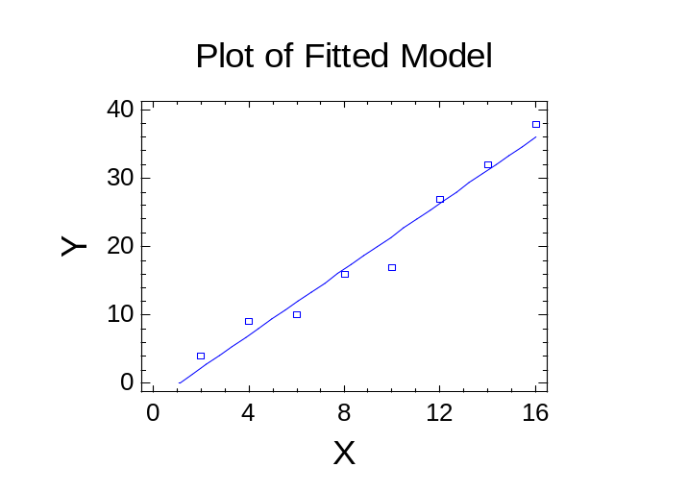
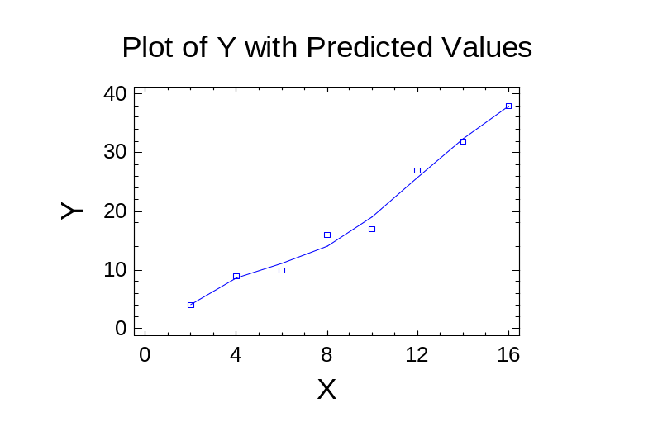
MULTIVARIATE REGRESSION METHODS
Many methods (neural networks, support-vector machines…)
Problem to avoid: “overfitting”: goodness-of-fit (R²) > goodness-of-prediction
R² = 0.964
R² = 0.989
Solution: split observations in two 2 sets
Calibration set → Fi the model, calculate s²_{residuals}
Validation set →
How does the model predict those observations not used to fit the model? → calculate s²_{residuals}
Both should be similar !
This “validation” is very common in regression, but MLR models are built with all observations and are validated with residuals…
50
Cross-validation methods (bootstrapping, jackknifing…)

